Slide 1
STAT7001 – Computing for Practical Statistics 2015 Lecture 5
Generalized Linear Models
Dr Franz J. Király

Slide 2
Generalized Linear Models

Slide 3




What is a Generalized Linear Model?
Recall: linear model
height~weight
Generalized linear model
smokes~height?
„link function“
linear model
logarithmic
logit

Slide 4
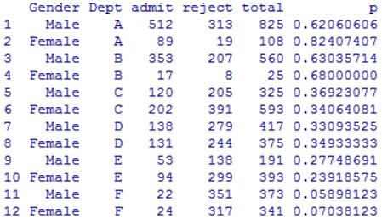
Today‘s example: UCB admissions
library(datasets)
help(UCBAdmissions)
The data set contains aggregate data on applicants to graduate school at Berkeley for the six largest departments in 1973 classified by admission and sex.
Reject/admit = number of total students with gender X admitted/rejected to
total = total number of students admitted/rejected to department Y
p = relative frequency of students with gender X admitted in department Y
(consult section 8.3 of Maindonald/Braun on how to obtain this table)

Slide 5

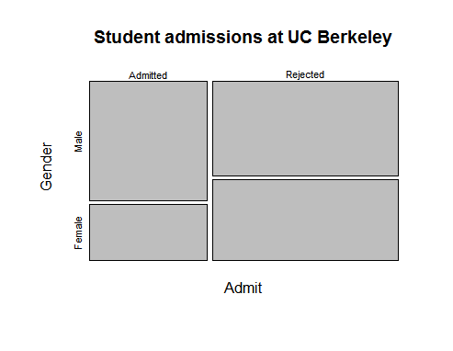

Today‘s example: UCB admissions
Main question: is admission fair with respect to variable gender?
apply(UCB, c(1, 2), sum)
mosaicplot(…)
chisq.test(…)
Have we used all information in the data?

Slide 6
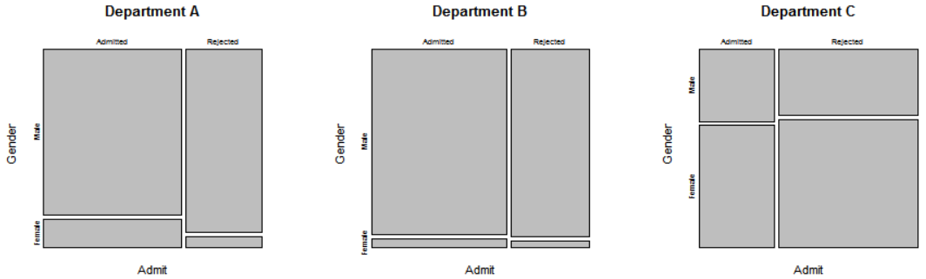
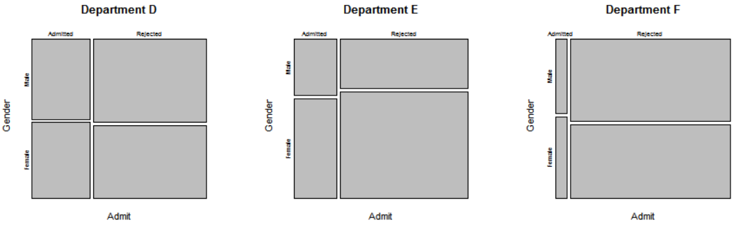
Memento Simpson‘s Paradox!
More females apply to departments with high rejection rates
Can we quantify this?

Slide 7

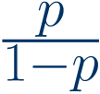
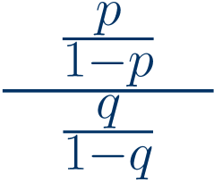

What are the odds?
(probabilities below do not correspond to probabilities in a real poker/Texas Hold‘em game, for illustratory purposes)
probability of some event
e.g. P(royal flush) = 0.001%
odds of that event
„royal flush“ has odds of 1:99999 to happen
(always positive)
odds ratio
the odds for „royal flush“ are better by a factor of 100, compared with „dead man‘s hand“
(always positive)
log odds ratio
This is linear in the log-odds!
(can be any real number)
Idea: in order to quantify admissions odds, fit a generalized linear model
with
„logistic regression“
Left side is the expected value of the logit.

Slide 8
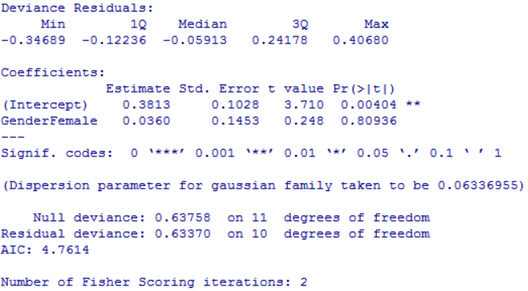


Fitting a generalized linear model
fits a linear link by standard, caution!
glm(p~Gender,data=UCB)
summary(UCB.glm)
residual quartiles (=RSS with link)
look for skewness &outliers
Coefficient estimate & st.error Coefficient statistic & p-value
Null = coefficient is zero
Deviances
Null deviance=
Res. deviance=
Residual deviance should be distinct from Null deviance in a „good“ model
Akaike‘s Information Criterion
(0Dev – Rdev is chi² with 10 degF)
(number of ML-iterations)
(trades off error with model complexity)
lower AIC indicates better explanatory strength
Something seems wrong here… ideas?
Specify link function by parameter family=…(link=…)
glm(p~Gender,data=UCB,family=binomial(link="logit"),…)
does logistic regression = GLM with logit link function

Slide 9
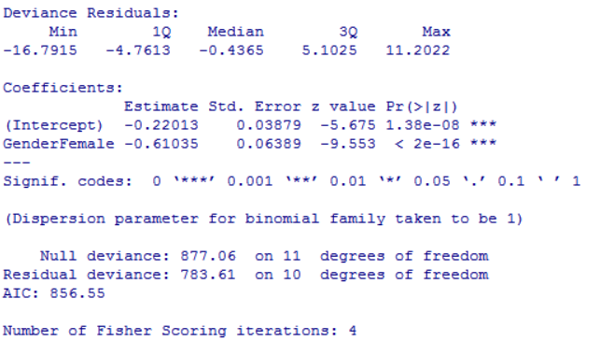
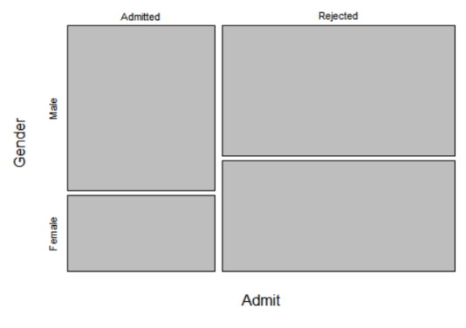
Fitting a logistic regression model
Two different ways to fit a logit model:
1. response variable is logical (non-aggregate case)
glm(admitted~Gender,data=UCB,family=binomial)
2. response variable is aggregate (as in the UCB example)
glm(p~Gender,data=UCB,family=binomial,weight=total)
needs total number of successes as parameter weight
Women are more likely to be rejected
The odds ratio women/men is
do you remember what „odds ratio“ means, from 2 slides ago?

Slide 10
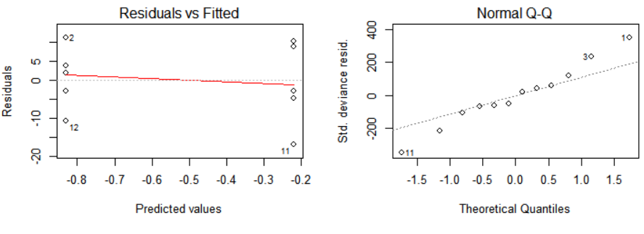
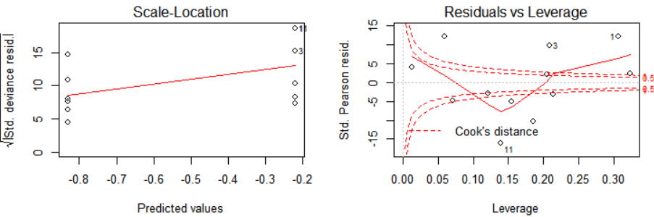
Diagnostic Plots
plot(UCB.glm)
yields same diagnostic plots as for linear regression
Careful: diagnostic plots can be problematic for aggregate data!
Better: look at deviance residuals in summary(UCB.glm)

Slide 11
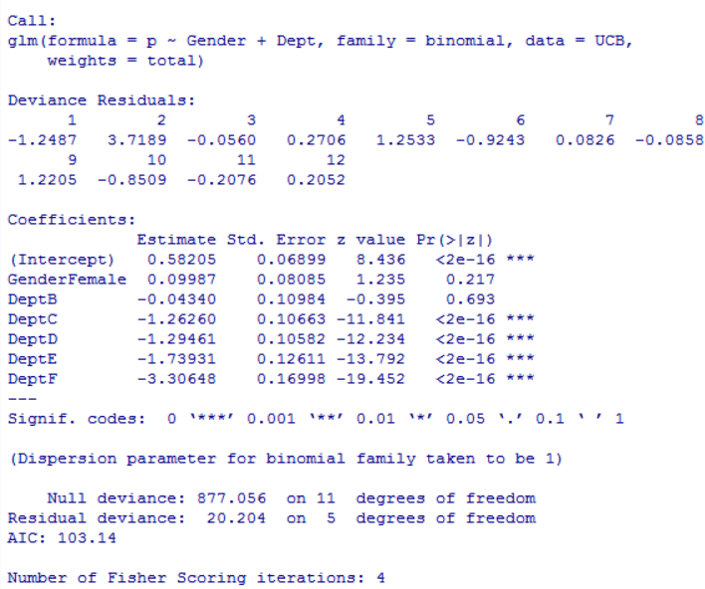
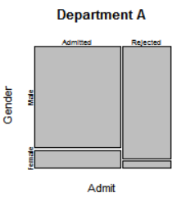
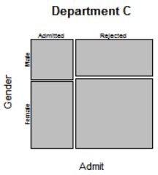
Refining the GLM
We have not used all information:
Dept should be studied.
glm(admitted~Gender+Dept,data=UCB,family=binomial,…)
Gender is not significant in this model
Dept is significant as explaining variable
Baseline is by default first occurring value (odds ratio is unchanged by choice of baseline)
The odds ratio Dept A/Dept C is
Does this answer the question?

Slide 12
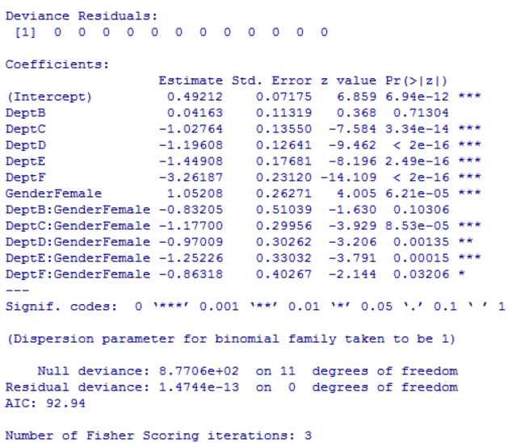
Interaction terms
Even though Dept is the major factor:
gender could have influence in each Dept
Include interaction terms with * (see lecture 4):
glm(admitted~Gender*Dept,data=UCB,family=binomial,…)
No residuals since this is aggregate data and we have fitted the model with maximal degrees of freedom
Dept is significant again
Gender is significant in interaction with Dept
Baseline is DeptA:GenderMale
Therefore GenderFemale describes Dept A
not the overall effect of gender!
For example:
The odds ratio Male/Female in Dept A is
The odds ratio Dept A/Dept C for Women is
Does this answer the question?
If yes, how?

Slide 13
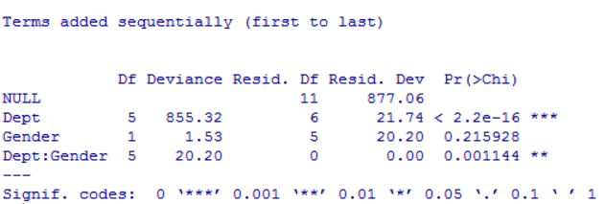
ANOVA for variable selection
anova(UCB.glm,test="Chisq")
sequentially adds variables by reduction of residual/deviance
test: chi²-test for significance
Dept is first variable added, significant
then gender – not significant
Interaction term comes last - significant
Recall the AIC for the models today:
Gender only
AIC = 857
Gender+Dept
AIC = 103
Gender*Dept
AIC = 93
Possible interpretation:
Dept preferences explain to great extent overall gender disparity
But: there are Dept-wise disparities which are (less but still) significant
Cave: ANOVA is not out-of-sample validation for a predictive model!

Slide 14
On model fitting
Fitting a linear or generalized linear model
should always follow a scientific rationale
target variable has to make scientific sense
good: pulseafter~ran+weight+sex
bad: sex~ran+name
link function should follow scientific rationale or exploratory analysis
binomial/logit for odds
Poisson for integers
do not treat non-ordinal variables as numeric!
1. inspect the model summary
How „good“ does the model explain?
Which variables are significant in the model?
2. diagnostic plots
Anything conspicuous?
3. refine model, if necessary
Drop/add variables? ANOVA?
4. quantification of goodness
Deviance, AIC for aggregate tables
out-of-sample error for predictive models
(more on this in lectures 7,9)

Slide 15
Interpretation and reporting

Slide 16
Interpretation of results
Put your findings into the scientific context:
Does your model describe a relationship/association? A dependence?
Has it been obtained from a question or from exploration?
Does it explain anything? Does it predict anything?
Have you tested it on unseen data, out-of sample?
If yes, it has the status of an experiment.
If not, it has the status of an observation.
When testing: specify significance level in advance
It is clean practice to do so before you do any tests, explorative or not
Rule-of-thumb: if lifes depend on it: 1% or less; if explorative: can do 5% or higher
Separate facts from interpretation and opinion
Carefuly be aware what your analysis tells you and what not!
Correlation is not causation! An observed relationship might not be causal.
List potential causes clearly as what they are: potential causes.

Slide 17
Interpretation: UCB admissions example
We investigated data on all N=4526 applications to graduate research degrees at UC Berkeley in 1973. The data included information on gender of the applicants (male/female), the application department (A to F), and whether the application was rejected or not.
We found that there a significant overall association between female gender and rejection (OR 1.84 ± 0.12, p < 2e-16).
BAD:
Since rejection cannot cause the gender, the gender must be related to the reason for the female applicants being rejected more significantly.
WORSE:
Cause/effect is not part of the data!
The cause for this to the best of our knowledge is
the known lower academic capabilities in females as compared to males.
Or: the known ongoing discrimination of female applicants during application.
Neither „academic capabilities“ nor „discrimination“ was part of the data!
(the above non-sequiturs have been part of the actual historical discourse on the UCB data set and do not reflect UCL’s or the lecturer’s view on the data or associated questions)
Data is apolitical!
Conclusions must be scientific!

Slide 18
Interpretation: UCB admissions example
We investigated data on all N=4526 applications to graduate research degrees at UC Berkeley in 1973. The data included information on gender of the applicants (male/female), the application department (A to F), and whether the application was rejected or not.
We found that there a significant overall association between female gender and rejection (OR 1.84 ± 0.12, p < 2e-16).
BETTER:
We found that this overall association can be mostly explained by stratification into the six different departments, for which both rejection rate and the female/male ratio vary considerably.
Fitting logistic models over all parameters and Analysis of Deviance revealed that gender is no longer a significant overall model parameter (p = 0.22) when controlling for department.
However, the interaction terms department/gender in the models remain significant (p = 1.1e-03) in all models, indicating possible department-specific preferences – depending on department, favouring either males or females.
(always stay clear about what is possibe explanation, and what is analysis)
We recommend close monitoring and future acquisition of department-specific data.
(optional; if you make recommendation, make clear that it is not part of the factual analysis!)

Slide 19
Writing a statistical report
Summarize data, experiments, findings, interpretation
Suggested structure:
Top of your report: summary/abstract
Interpretation/recommendation, if applicable
Relation to prior analysis/literature - not needed for ICA
but otherwise mandatory!
Description of your data: variables, structure, acquisition, cite source (study or project)
Description of your analyses: questions, numbers, outcomes
Interpretation of your results, discussion and outlook
Appendix: description of file structure, code location, repository of results
attach your code and analyses for reproducibility (e.g. as a file on CD)

Slide 20
After Reading Week: SAS
If data were punchcards

Slide 21
Week 5 Learning Objectives
Generalized Linear Models
Understand the GLM setting and the link function
Understand how GLM for binomial target works
Fitting Generalized Linear Models in R
How to fit a GLM for an R model, link functions
Aggregate data vs non-aggregate data
GLM summary: significance, deviance, AIC
Model Selection for Linear Regression and GLM
Which model(s) to start with after exploration
Diagnostic plots and model assessment
Dropping and adding variables, outliers, rescaling

